Slide 1
Python: Lesson #4
Lists
By: Marc Geffroy

Slide 2
What was covered last week?
What is a module.
Syntax for importing and using a module.
ASCII Table.
String manipulation.

Slide 3
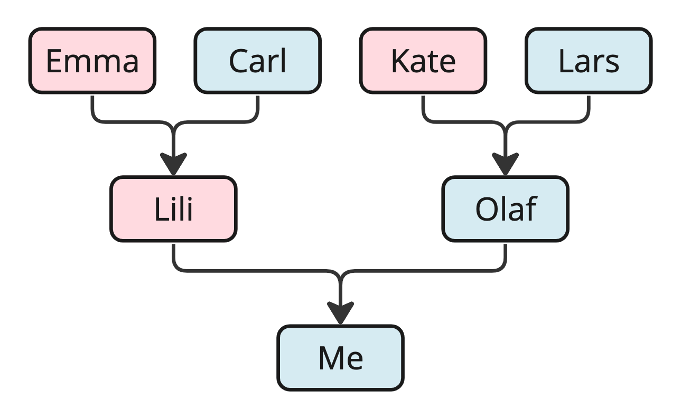
Data Structures
What is a data structure?
A way of formatting data so that it can be used by a computer program or other system
Why use data structures?
allow users and systems to efficiently organize, work with and store data

Slide 4
Data Structures
Data structures combine primitive data types such as numbers, characters, booleans and integers into a cohesive format.
A data structure, enables higher-level data operations such as sorting, searching, insertion and deletion.
Example: Arrays, Queues, Stacks, Linked lists, Trees, Graphs, Hash
Common Python DS: List, Dict

Slide 5
Lists
A collection of comma separated values.
Analogues to dynamically sized arrays in other declared languages.
The most versatile datatype in Python
Does not need to contain a single data type.
Lists are order and a have a definite count.
Are changeable (mutable).
Allow duplicates.
Are indexed.
myClassObject = MyClass() myList = [‘Chemistry’, ‘USA’, 2, myClassObject, 2.34]

Slide 6
List Functions
myList = [‘Chemistry’, ‘Afrikaans’, ‘Programming’, ’Maths’]
Accessing a list:
myList[1]
myList[-2]
myList[1: 3]
Changing values
mylist[0] = ‘English’
myList[0: 2] = [‘Science’, ‘French’]
Adding Values
myList.insert(1, ‘Science’)
myList.append(‘Science’)
myList.extend(anotherList)
Removing values
myList.remove(‘Chemistry’)
myList.pop(1)
del myList[1]
del myList
myList.clear()

Slide 7
List Functions
myList = [‘Chemistry’, ‘Afrikaans’, ‘Programming’, ’Maths’]
Looping
for item in myList: print(item)
for i in range( len(myList) ): print(myList[i])
if ‘Chemistry’ in myList: print(‘It is there.’)
Copying List
newList = myList.copy()
newList = list(thisList)
Sort
myList.sort()
Count - number of elements with a specified values
myList.count(‘English’)

